Slide 1




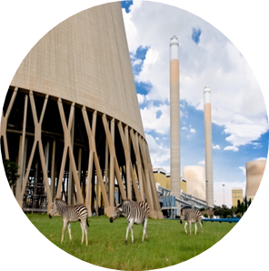

Spherical Header Tutorial
From primitive parts
Stefan van der Walt
vdwalts@eskom.co.za
09/11/2016

Slide 2
Background
In this tutorial a basic spherical header with two branches will be created using primitives.
A static finite element analysis will then be set up and solved.
The results will be displayed with the built-in results view.
The results will then be displayed using the VTK post-processor.

Slide 3
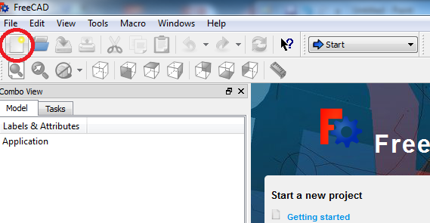
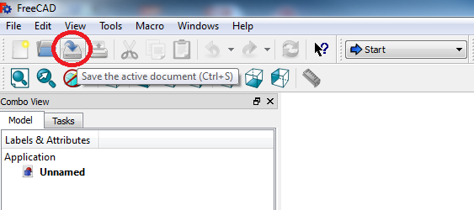
Project Startup
Create the Project:
When you open Freecad, the home screen appears.
Create a new document by clicking on the ‘Create a new empty document' icon.
It is a good idea to save the document before starting. Click on the ‘Save’ icon on the taskbar. Name the file “Basic Header Tutorial”.
Remember to save regularly.

Slide 4
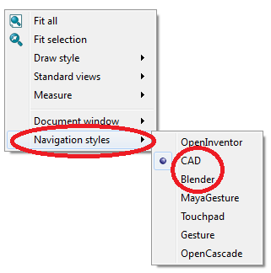
Basics – Mouse Navigation
Basic navigation
There are different navigation modes available within Freecad. If you right-click anywhere on an open part of the display window, you can select the navigation mode you prefer.
The ‘CAD’ and ‘Blender’ navigation styles are two of the most commonly used styles.

Slide 5
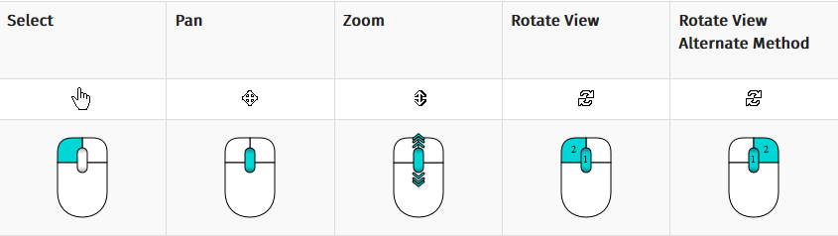
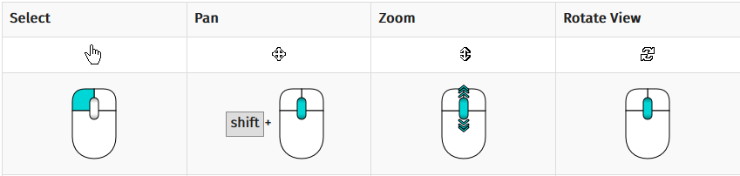
Basics – Mouse Navigation
Rotate parts with navigation styles
It is important to know how to rotate parts with these navigation styles.
If the Blender style is selected, a part can be rotated by clicking and holding the middle mouse button.
If the CAD style is selected, you can rotate a part by clicking and holding both the middle mouse button and the left mouse button.
The images on the right summarises the main mouse functions.
CAD Navigation
Blender Navigation

Slide 6
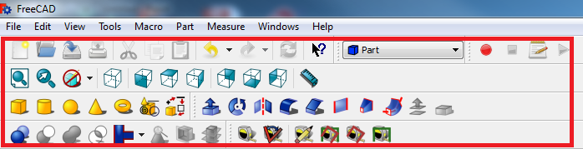
Basics - Layout
Screen layout and terminology
Certain terms will be used throughout the training material, which will be shown here.
The taskbar refers to the area at the top of the screen where all the relevant icons are located. The icons will change whenever the workbenches are changed. The example shown here is of the taskbar with the general icons as well as the Part workbench icons.
The entire area enclosed within the red box is referred to as the taskbar.

Slide 7
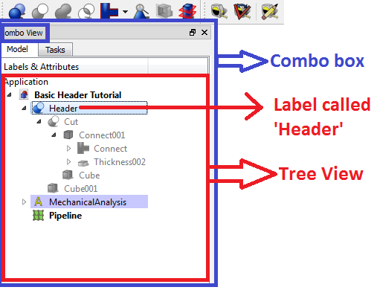
Basics – Layout
Other terms often used are the tree view, combo box and label.
The tree view, which is contained within the combo box, refers to the window in which all the parts and features that was created and applied to the model are displayed.
In the example shown, the tree view contains features added with the parts workbench as well as features added with the FEM workbench. Each item in the list is called a ‘Label’ and has a name. If you click on a label you can edit its properties which appear underneath the tree view.
You can hide a label by clicking on it and pressing spacebar.

Slide 8
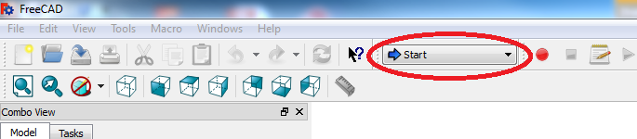
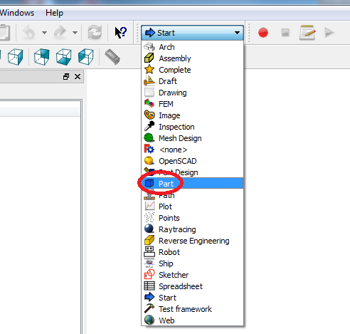
Project Startup
Create the Project:
The workbench dropdown menu is located at the top of the screen on the taskbar. If Freecad has just been opened, it will display ‘Start’.
Click on the workbench dropdown menu. The menu will expand and display all the available workbenches within Freecad.
Click on the ‘Part’ workbench.

Slide 9
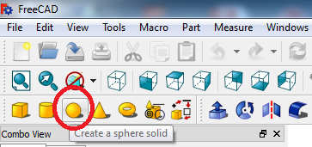
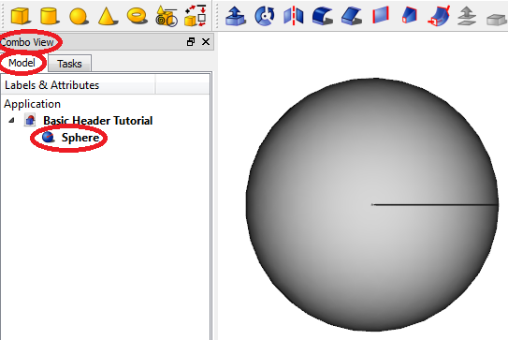
CAD Model - Spherical Part
Spherical Part
To insert a sphere into your document, click on the ‘Sphere’ primitive on the taskbar.
In the Combo View box under the ‘Model’ tab a sphere will appear in the tree view of the document.

Slide 10
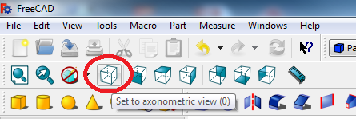
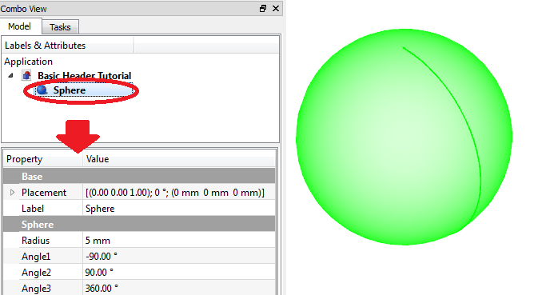
CAD Model - Halving the sphere
Halving the sphere
First we need to set the display window to ‘axonometric view’. This can be done by clicking on the icon on the taskbar
Hint: You can access the shortcuts for the 7 different views by pressing the ‘0’ to ‘6’ keys on your keyboard. ‘Axonometric view’ is ‘0’.
Click on the ‘Sphere’ label in the tree view to display its properties.

Slide 11
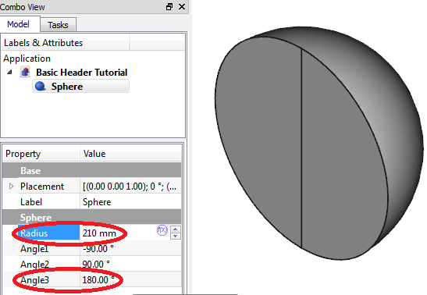
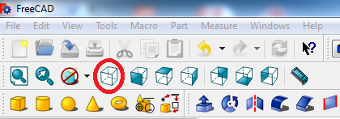
CAD Model - Halving the sphere
In the ‘Properties’ box, change the ‘Angle3’ to 180°. This will change the sphere to half a sphere. (i.e. if you change it to 90° it will change to a quarter of a sphere etc.).
In the same properties box, change the radius of the sphere to 210mm.
Since the original radius was 5mm, the sphere is now too big to be visible on the screen. In order to fit the enlarged sphere in your screen, click on the ‘Fit content on screen’ icon on the taskbar

Slide 12
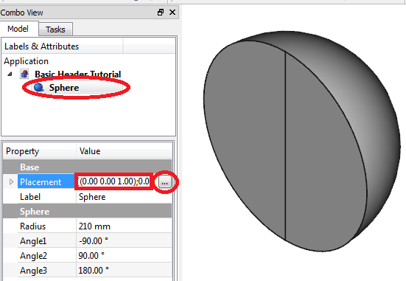
CAD Model - Rotating the sphere
Rotating the sphere
It can clearly be seen that the half sphere need to be rotated in order for the ‘bottom’ part of the half sphere to be downwards.
In order to rotate the half sphere, select to sphere to open its ‘Property’ box, and click on the box next to placement. A small icon with an ellipse on it appears . Click on it to open the ‘Placement’ properties of the half sphere.

Slide 13
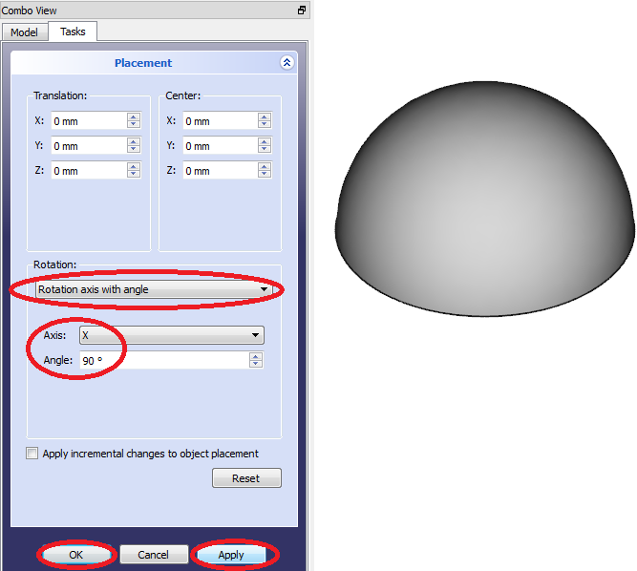
CAD Model - Rotating the sphere
After opening the ‘Placement’ properties for the half sphere, we need to select the ‘Rotation axis with angle’ in the dropdown menu under ‘Rotation’.
Select the ‘X’ axis next to the ‘Axis’ heading.
Change the angle to 90°.
Click ‘Apply’ to apply the changes. The half sphere will have rotated with its ‘bottom’ part downward.
Click ‘OK’ to close the box.

Slide 14
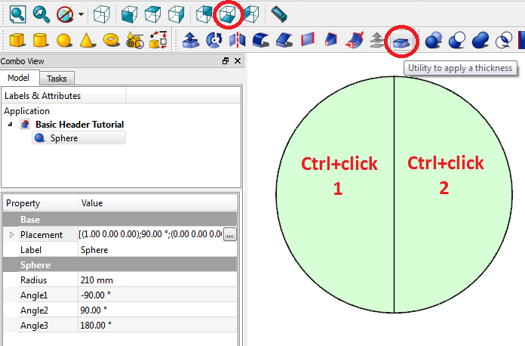
CAD Model – Applying a thickness
Applying a thickness to the sphere
In order to apply a thickness (hollowing out the sphere), we need to rotate the half sphere until the bottom part is visible. This can be done either by selecting the ‘Bottom’ view from the taskbar or by pressing its shortcut on the keyboard ‘5’.
Now select the bottom surface(s) by pressing and holding the ‘Ctrl’ button while clicking.
When all the bottom surfaces have been selected, click on the ‘Utility to apply a thickness’ button on the taskbar. Its box automatically opens.

Slide 15
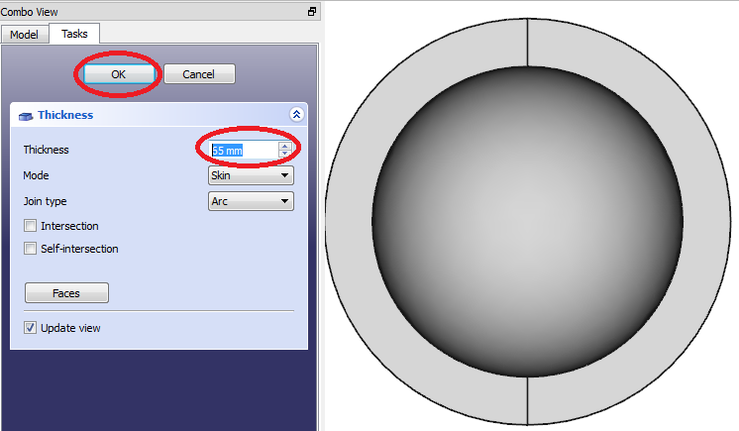
CAD Model – Applying a thickness
After selecting the ‘Utility to apply a thickness’, a box will automatically open.
Change the thickness to 65mm. You will see the thickness being added to the outside of the sphere.
Click ‘OK’ to apply the changes and close the dialogue box.

Slide 16
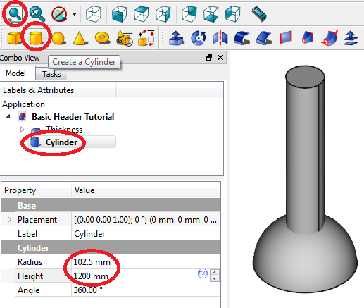
CAD Model – Adding a cylinder
Adding a cylinder for the branch
Select the axonometric view again by selecting its icon on the taskbar or by pressing the number ‘0’ key on your keyboard.
Click on the ‘cylinder’ primitive in the taskbar to insert a cylinder into the document.
You will see the cylinder label appear in the tree view. Click on it to open its properties box.
Change its radius to 102.5mm and its length to 1200mm.
Click on the ‘Fit content to window’ icon to zoom out.

Slide 17
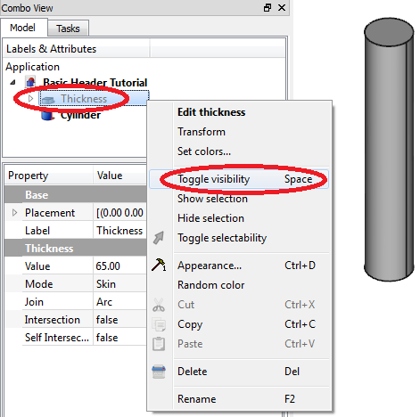
CAD Model – Applying thickness to cylinder
Applying a thickness to the cylinder
To apply a thickness to the cylinder in order to change it to a pipe, we need to be able to access both the top and bottom surfaces. But the half sphere might be in the way, so we need to hide the sphere temporarily.
In order to hide the sphere, either right click on the ‘Thickness’ label on the tree view and select ‘Toggle visibility’, or press space bar on our keyboard as a shortcut.
You will see the half sphere disappear and the ‘Thickness’ label on the tree view will grey out.

Slide 18
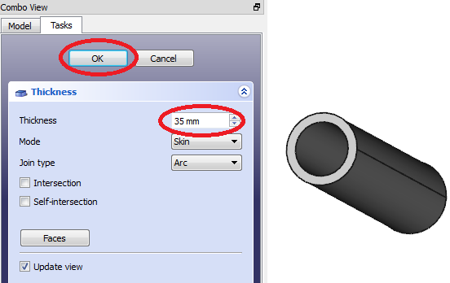
CAD Model – Applying thickness to cylinder
Select the top and bottom surface of the cylinder by using ‘ctrl+click’.
After selecting both surfaces, click on the ‘Utility to apply thickness’ in the taskbar.
Set the thickness to 35mm.
Click ‘OK’ to apply the thickness and close the dialogue.

Slide 19
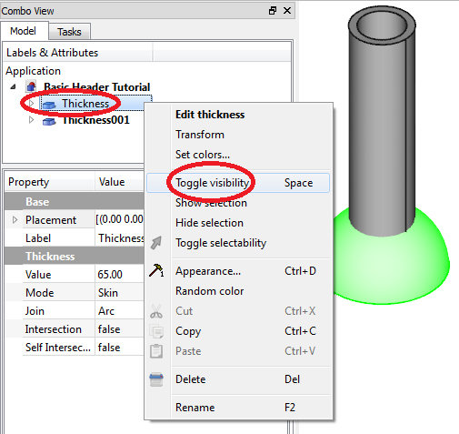
CAD Model – Rotating branch
Rotating the branch
Since the branch of the spherical header is not upright but at an angle, we need to rotate the branch around the y-axis.
In order to visualise the relative rotation to the spherical part of the header, we need to toggle the visibility of the half sphere.
Click on the greyed-out ‘Thickness’ label in the tree view and press ‘spacebar’ (or right click on the label and select ‘Toggle visibility’.
Both the spherical and the cylindrical part of the header should be visible.

Slide 20
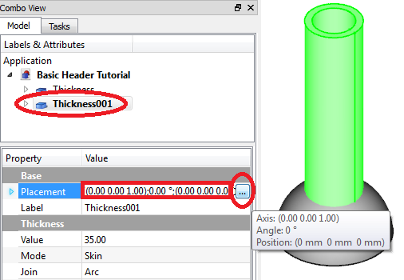
CAD Model – Rotating branch
Select the label ‘Thickness001’ which contains the cylindrical branch.
In its properties box, click on the cell next to ‘Placement’. Click on the icon with the ellipse that appear.
A dialogue box opens.

Slide 21
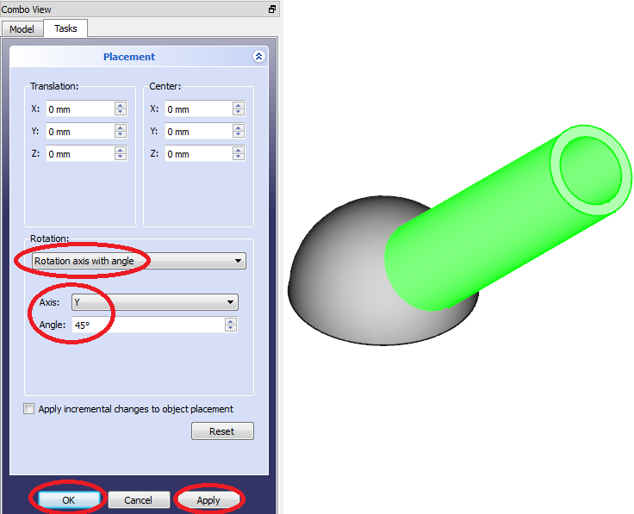
CAD Model – Rotating branch
Under ‘Rotation’, select ‘Rotation axis with angle’.
Next to ‘Axis’, select ‘Y’ –axis.
Next to ‘Angle’, type in ‘55’ to rotate the branch 45º.
Click on ‘Apply’ to apply the changes and on ‘OK’ to close the dialogue box.

Slide 22
CAD Model – Adding second branch
Adding a second branch
To add a second branch, follow the exact same steps to add a cylinder.
Give the cylinder the same dimensions as the first cylinder – make the radius 102.5mm and the length 1200mm.
Toggle the visibility of both the ‘Thickness’ labels by clicking on each one individually and pressing spacebar.
Select the top and bottom surfaces of the cylinder and apply a thickness of 35mm.

Slide 23
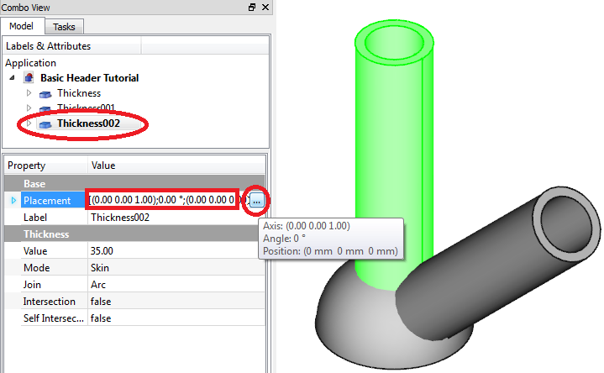
CAD Model – Rotating second branch
Rotating the second cylinder
Toggle the visibility of the hidden parts again by using spacebar.
Click on the cylinder’s label in the tree view. It should be ‘Thickness002’.
In the properties box, click on the cell next to placement and click on the icon with ellipse that appear.
A dialogue box appear.

Slide 24
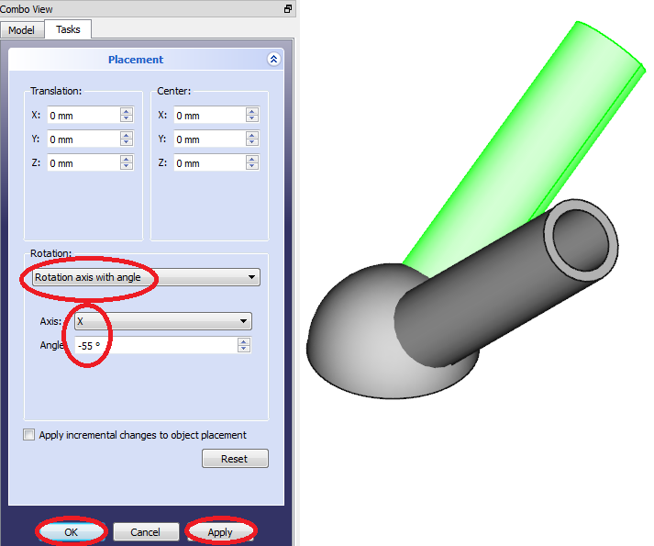
CAD Model – Rotating second branch
Under ‘Rotation’, select ‘Rotation axis with angle’.
Next to ‘Axis’, select ‘X’ to rotate the cylinder around the x-axis.
Next to ‘Angle’, type in ‘-55’ to rotate the cylinder 55º in the negative (backwards) direction.
Click on ‘Apply’ to apply the changes and on ‘OK’ to close the dialogue.

Slide 25
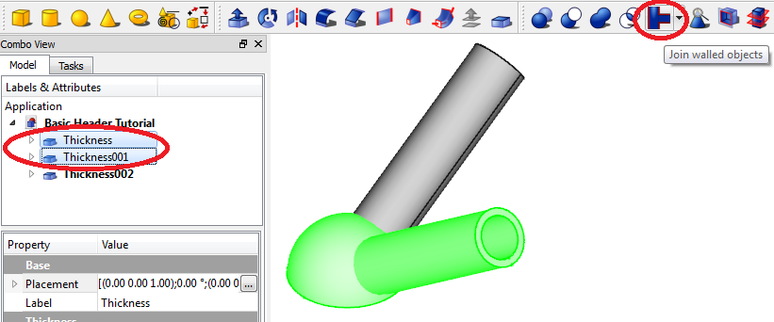
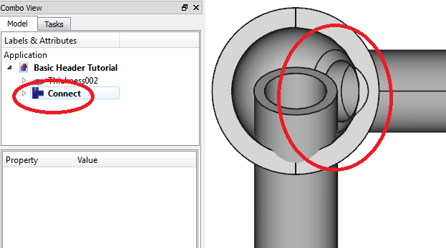
CAD Model – Join walled objects
Join walled objects
The 3 different parts need to be joined in one single part. This must be done one branch at a time.
In the tree view, select the first ‘Thickness’ label and ‘ctrl+click’ the second label to select both.
Click on the ‘Join walled object’ icon in the taskbar.
This joins the two parts and creates a new label in the tree view called ‘Connect’.

Slide 26
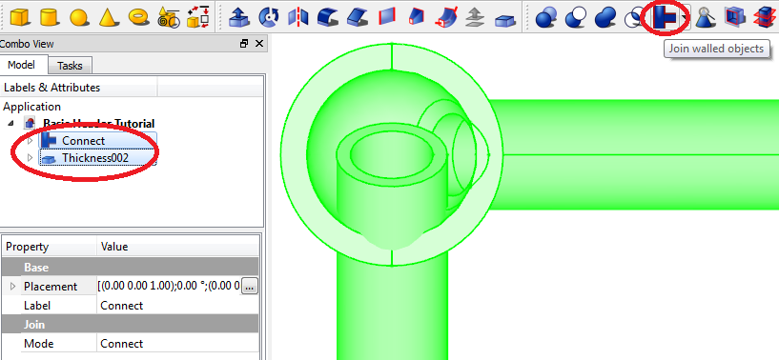
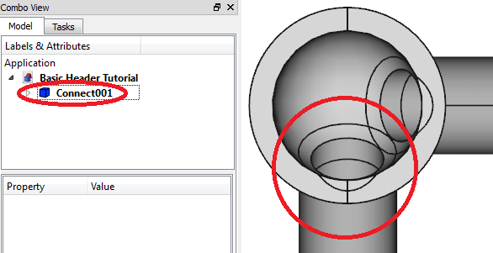
CAD Model – Join walled objects
In order to join the second branch to the body, click on the ‘Connect’ label in the tree view and then ‘ctrl+click’ on the remaining ‘Thickness002’ label.
Click on the ‘Join walled objects’ icon in the taskbar.
A new label ‘Connect001’ appears and all the other labels are now contained within this label.

Slide 27
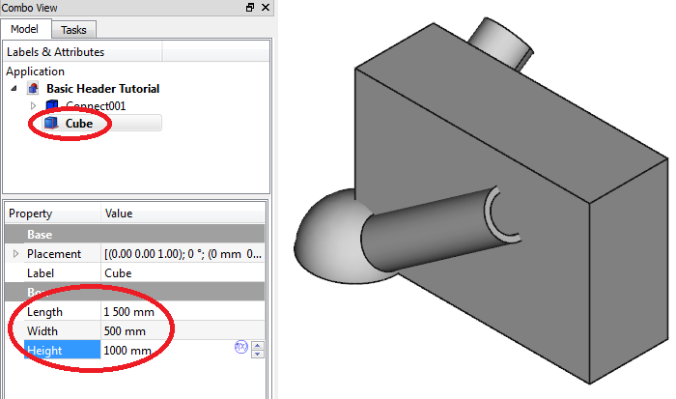
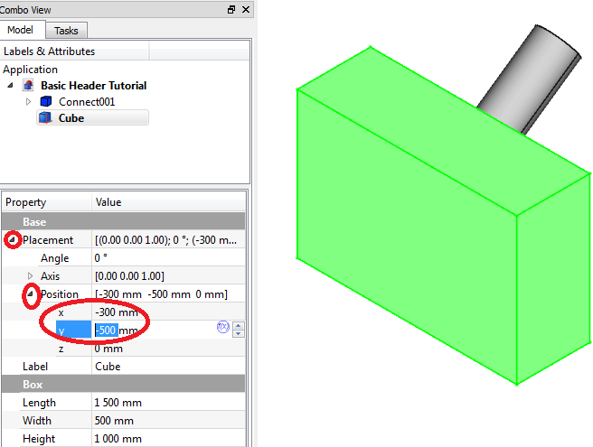
CAD Model – Cutting the geometry
Cutting the geometry
Due to symmetry, we can cut the part until only a quarter is left.
In order to do this, click on the ‘Cube’ icon in the taskbar to insert a cube primitive.
Click on the ‘Cube’ label in the tree view and change its length to 1500mm, its width to 500mm and its height to 1000mm.
Expand the ‘Placement’ heading by clicking on the white arrow next to it, and then expand ‘Position’.
Change the x and y-coordinate to -300mm and -500mm respectively.

Slide 28
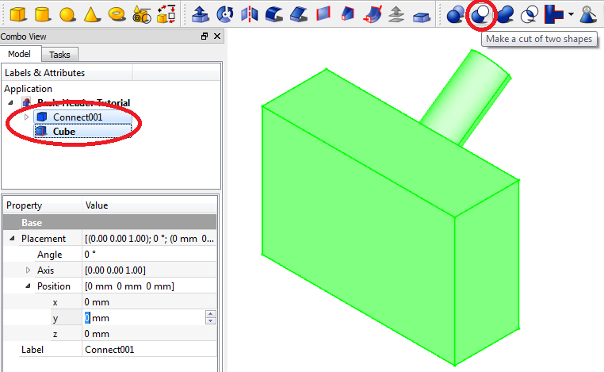
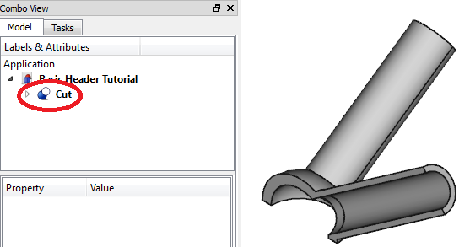
CAD Model – Cutting the geometry
In order to cut the part, we first need to select the part we want to keep, and after that select the part we want to use to cut away the material.
In this case, click on the ‘Connect’ label in the tree view first. Now ‘ctrl+click’ the ‘Cube’ label in the tree view.
Click on the ‘Make a cut of two shapes’ icon in the taskbar.
A new label appear in the tree view.

Slide 29
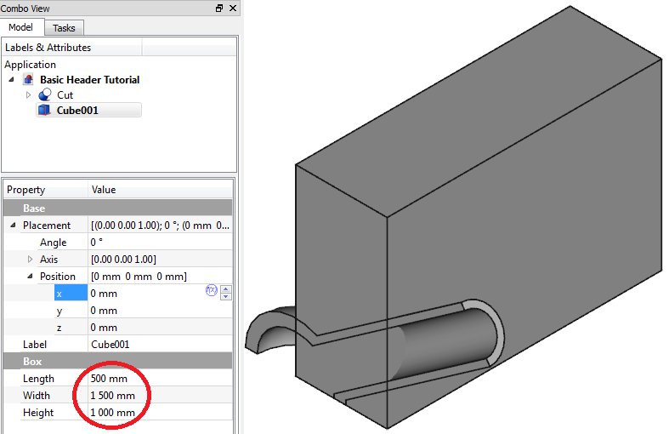
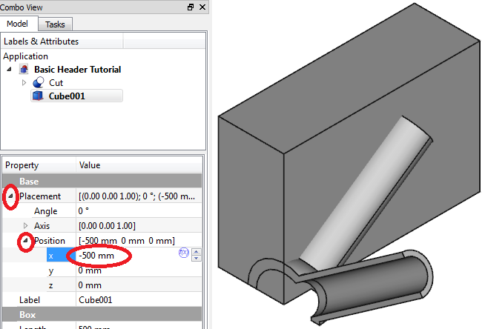
CAD Model – Cutting the geometry
The part is now cut in half, now we need to cut the remaining part in half as well.
Click on the ‘Cube’ icon in the taskbar to insert a cube.
Click on the ‘Cube001’ label in the tree view. Under its properties, change its length to 500mm, its width to 1500mm and its height to 1000mm.
Expand the ‘Placement’ heading by clicking on the white arrow then expand the ‘Position’ heading.
Change the x-coordinate to -500.

Slide 30
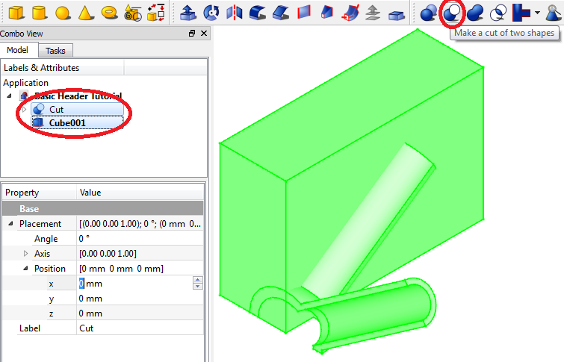
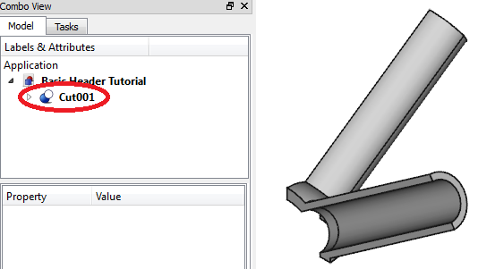
CAD Model – Cutting the geometry
Now first click on the ‘Cut’ label in the tree view, and then ‘ctrl+click’ on the ‘Cube001’ label in the tree view.
Click on the ‘Make a cut of two shapes’ icon.
A new label appears in the tree view ‘Cut001’.

Slide 31

FEM
Setting up, solving and displaying results for the header.

Slide 32
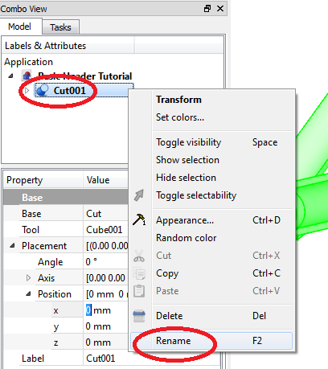
FEM Model – New analysis
Create new analysis with mesh
Now that the CAD model is complete, the Finite Element Analysis (FEA) need to be setup
First we need to rename the part, since its current name as displayed in the tree view is ‘Cut001’
In the tree view, right click on the label ‘Cut001’ and click ‘Rename’.
Type in ‘Header’ and press ‘Enter’ on the keyboard.
The name should now be displayed as ‘Header’.

Slide 33
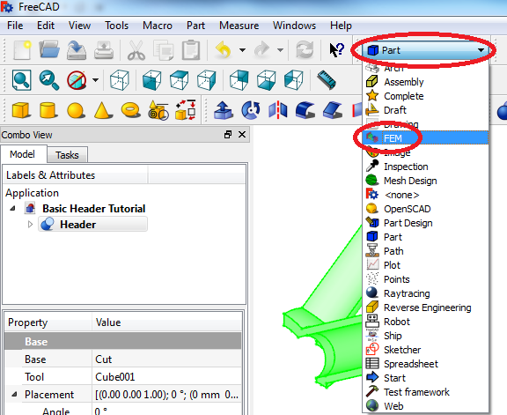
FEM Model – New analysis
Click on the workbench dropdown menu in the taskbar and select the ‘FEM’ workbench.
Select the part by clicking on the label ‘Header’ in the tree view. When the part is selected, it will display green in the display window.

Slide 34
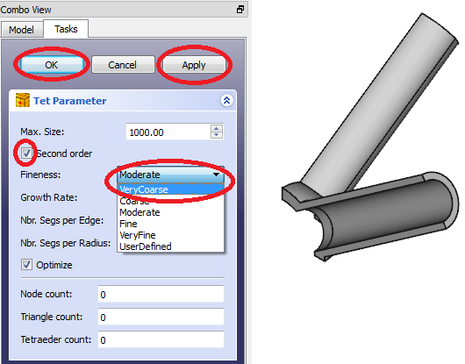
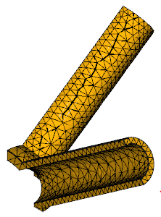
FEM Model – New analysis
Click on the ‘Create New Mechanical Analysis’ icon on the taskbar. Since the part was selected before clicking on the new analysis, the meshing window will automatically appear.
Ensure the tick box next to ‘Second order’ is selected.
Click on the dropdown menu next to ‘Fineness’, and select ‘VeryCoarse’. This is the fineness of the mesh. Remember to always start with a coarser mesh since the solution time is shorter. When the model solves correctly, the mesh fineness can be adjusted.
Click on ‘Apply’ and then on ‘OK’.

Slide 35
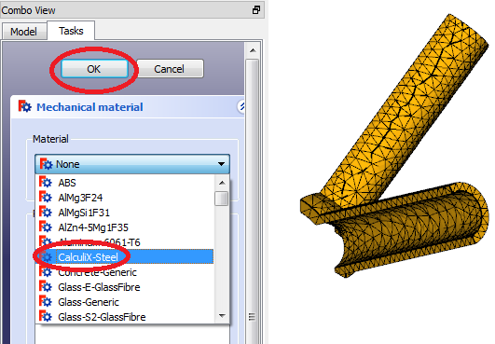
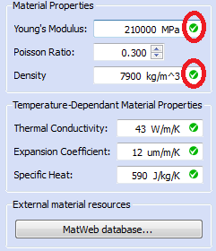
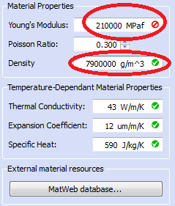
FEM Model – Adding material
Adding a material
Click on the ‘Add Material’ icon on the taskbar. A dialogue box will appear.
Click on the dropdown menu under ‘Material’, and select the generic material called ‘CalculiX-Steel’.
Ensure the material properties are correct, including the units. If a green tickmark is displayed next to the unit, then the unit is acceptable. If a red crossed-out circle is displayed, then the units are wrong or inconsistent.
Click on ‘OK’ to close the dialogue box.

Slide 36
FEM Model - Symmetry
Compensating for symmetry
In order to prevent rigid body motion, the model need to be constrained in all three directions. This will be done with the constraints added to compensate for symmetry.
Since the two branches were cut in half, the cross-sectional area need to be constrained to remain fixed in the direction normal to the surface, since this is what will happen if an internal pressure was applied to the entire pipe.
We will use the constraint called ‘Displacement Constraint’.

Slide 37
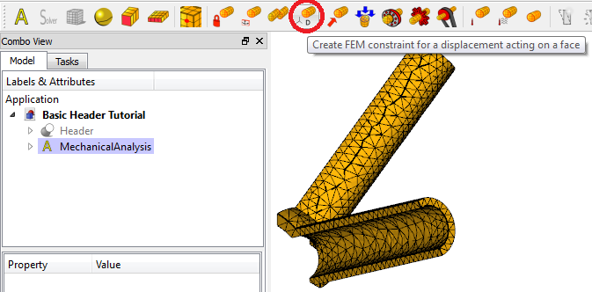
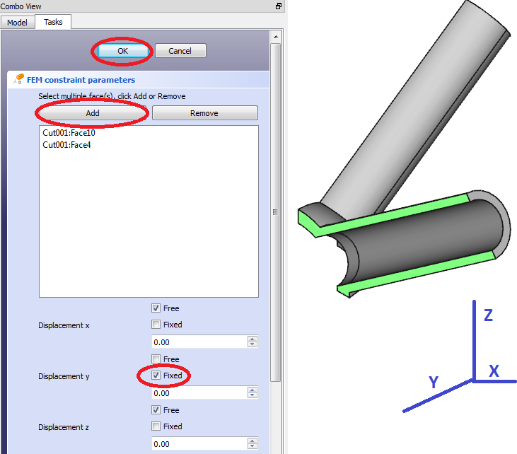
FEM Model – Displacement constraint
Click on the ‘Add Displacement Constraint’ on the taskbar.
Select the cross-sectional surface normal to the y-axis by using ‘ctrl+click’, and click on the ‘Add’ button. The surfaces will appear on the list.
Click the ‘Fixed’ tick box next to the ‘Displacement y’ heading to fix the displacement in the y-direction.
Click on ‘OK’ to close the dialogue box.

Slide 38
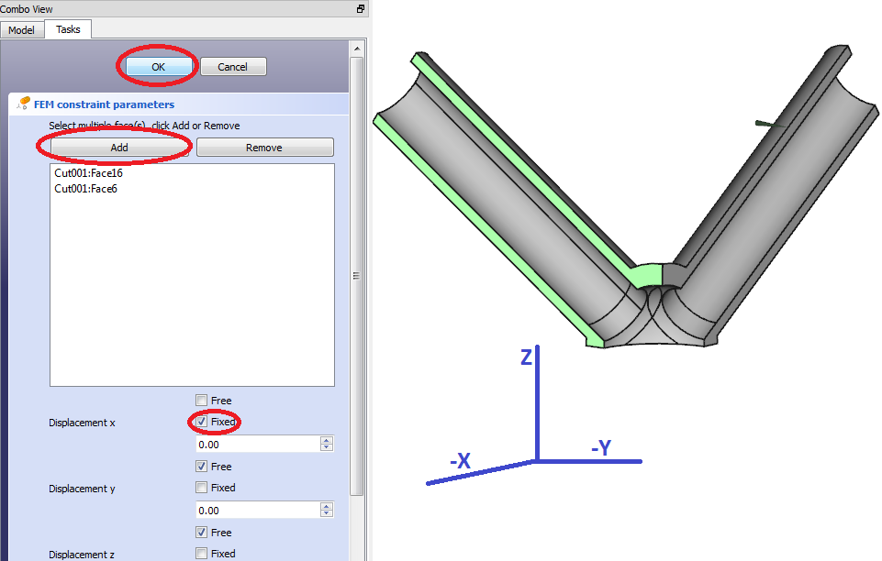
FEM Model – Displacement constraint
A symmetry constraint need to be applied to the other branch as well.
Click on the ‘Add Displacement Constraint’ icon in the taskbar.
Rotate the model in order to view the cross-sectional area of the branch normal to the x-axis.
Select the cross-sectional surfaces of the branch normal to the x-axis by using ‘ctrl+click’. Click ‘Add’ to add the surfaces to the list.
Select the ‘Fixed’ check box next to ‘Displacement x’ to fix the displacement of the selected surfaces in the x-direction. Click ‘OK’ to close the dialogue box.

Slide 39

FEM Model – Displacement constraint
The final symmetry constraint will be added to the bottom surfaces of the model that is normal to the z-axis.
Click on the ‘Add Displacement Constraint’ icon.
Rotate the model to display the bottom of the model. Select the bottom areas normal to the z-axis.
Select the surfaces by using ‘ctrl+click’. Click ‘Add’ to add the selected surfaces to the list.
Select the ‘Fixed’ check box next to ‘Displacement z’ to fix the displacement in the z-direction. Click ‘OK’ to close the dialogue.

Slide 40


FEM Model – Pressure Constraint
Adding internal pressure
The internal pressure due to the steam need to be added. Click the ‘Add Pressure Constraint’ icon on the taskbar. A dialogue box opens.
Rotate the model to display all the internal surfaces, and select it by using ‘ctrl+click’. Click on ‘Add’ to add the selected surfaces to the list. If a lot of surfaces need to be selected, do it a couple of surfaces at a time.
Change the pressure to 17.1 MPa.
Click ‘OK’ to close the dialogue box.

Slide 41


FEM Model – Longitudinal stress
Adding longitudinal stress
The internal pressure that was just added represents the hoop stress component, but the longitudinal stress component still need to be presented as well. A force applied the surface at the end of the pipe can be added for this.
The calculation needed for a full pipe is shown on the right.
P = Internal pressure of the pipe
D_{m} = mean diameter (internal diameter plus thickness)
t = Wall thickness of pipe
A_{cross} = Cross-sectional area of pipe
Longitudinal stress for a full pipe
$σ_{long}=\frac{P×D_{m}}{4×t}$
$σ_{long}=\frac{17.1MPa×\left(205+35\right)mm}{4×35mm}$
$σ_{long}=29.3MPa$
$F=σ_{long}×A_{cross}$
$F=29.3MPa×\frac{π}{4}({275mm}^{2}−{205mm}^{2})$
$F=773 209N$
Since we model only half a pipe, we only apply the force to half the cross-sectional area. Due to this, the force need to be multiplied by half:
$F=σ_{long}×{(0.5×A}_{cross})$
$F_{half}=0.5×F=0.5×773209N=386604.5N$

Slide 42

FEM Model – Longitudinal stress
Click on the ‘Add a Force’ constraint icon on the taskbar. A dialogue box opens.
Click ‘Add reference’ and then click on the cross-sectional area at the tip of one of the pipes. Since the direction will differ for the other pipe, we need to add a separate force constraint for the other pipe.
Change the Load to the calculated load needed for the longitudinal stress (386 604.5N). If arrows in the display window points in the opposite direction, click on the ‘reverse direction’ box to reverse the direction. Click ‘OK’ to close the dialogue.

Slide 43

FEM Model – Longitudinal stress
Similarly Add another force constraint for the other branch as well, using the same value for the applied force.
In order to view all the constraints added to the model, click on the white arrow next to the ‘MechanicalAnalysis’ label in the tree view. This will expand all the features and constraints relevant to the analysis.
It should look similar to the image displayed on the right.

Slide 44

FEM Model – Setting number of CPU’s
Setting the number of CPU’s
Before the analysis is run, set the number of CPU’s the solver can use. This will optimise the performance and decrease the solution time.
Determine the amount of CPU’s on your computer by pressing ‘ctrl+alt+del’ and then by selecting ‘Start Task Manager’. The Windows Task Manager window opens.
Select the performance tab at the top and count the number of boxes under ‘CPU Usage History’. This is the amount of CPU’s your computer has.

Slide 45

FEM Model – Setting number of CPU’s
After determining the number of CPU’s on your computer, expand the ‘MechanicalAnalysis’ label in the tree view by clicking on the arrow next to it.
Click once on the ‘CalculiX’ label. This opens the properties for the solver.
Enter the number of your CPU’s minus 1 in the box next to ‘Num Cpus’. The reason to leave one CPU open is to give the other system processes one CPU to use.

Slide 46


FEM Model – Running the analysis
Running the analysis
All the constraints have been added and the problem can now be run.
In the tree view, expand the label ‘MechanicalAnalysis’ by clicking on the white arrow next to it.
Double-click on the ‘CalculiX’ label. This will open a dialogue box for the CalculiX solver.
Click on the radio button next to ‘Static’.
Click on ‘Write .inp file’. Whait until it’s finished.

Slide 47

FEM Model – Running the analysis
After the text ‘Write completed’ is displayed underneath the ‘Run CalculiX’ button, the ‘Run CalculiX’ button can be clicked to run calculix.
Wait for the solver to finish by displaying the text ‘Calculix done!’ in green in the text box underneath the ‘Run CalculiX’ button.
Click ‘Close’ to close the dialogue.

Slide 48

FEM Model – Display results
Display results using ‘Results’ icon
After the ‘CalculiX’ solver have been run and the dialogue box have been closed, the results can now be viewed.
But in order to be able to view the results properly, the constraints that are visible in the in the display window need to be hidden.
In the tree view, click once on the first constraint and press spacebar to hide the constraint. The label for the constraint will turn grey. Pressing spacebar again will make the constraint visible again. Repeat this until all constraints are hidden.

Slide 49


FEM Model – Display results
Display results using ‘Results’ icon
To view the results, click on the ‘Display Results’ icon on the taskbar or double-click the ‘Results’ label in the tree view to open the results dialogue box.

Slide 50

FEM Model – Display results
The mesh will automatically appear on the model in the display window. When you click on the radio button of one of the results, for instance ‘Von Mises stress’, a color gradient of the results will apear on the model and its minimum, maximum and average values will be displayed in the results block.

Slide 51

FEM Model – Display results
Displacement using slider
The displacement of the model can also be shown by magnifying its effect in the display window.
Under ‘Displacement’, select the tick box next to ‘Show’, and slide the slidebar to see an exaggerated displacement of the part.
If the displacement is not exaggerated enough, the maximum value of the slider can be adjusted in the box next to ‘Slider max’ to increase the exaggeration of the displayed displacement.

Slide 52

FEM Model – Display results
Display user-defined results
If you want to display different values (like stress intensity, which is P_1 – P_3 of your principal stresses), you can define it in the text box at the bottom and click ‘Calculate and plot’ to show the colour gradient on the sketch, and its maximum, minimum and average values will display in the relevant boxes.
Click on ‘Close’ to close the results dialogue.

Slide 53

FEM Model – Display results (VTK)
Displaying basic results using VTK
Before the results using the VTK post-processor can be viewed, the mesh and/or model displayed in the display window need to be hidden.
In the tree view, if the ‘Header’ label representing the CAD model is not greyed out, click on it once and press spacebar.
In the tree view, if the label ‘Cut001_Mesh’ is not greyed out, click on it once and press spacebar to hide it.
The results window should now be empty and the model and the mesh labels should be grey.

Slide 54

FEM Model – Display results (VTK)
In order to display the results via VTK post-processing, the post-processor needs to be linked to a result.
In the tree view, click once on the ‘Result’ label and click on the ‘Create Post-Processing Pipeline’ icon in the taskbar. A new label will appear in the tree view for the pipeline.

Slide 55



FEM Model – Display results (VTK)
Double-click the ‘Pipeline’ label in the tree view to open the display options for the VTK post-processor pipeline.
Click on the dropdown menu next to ‘Mode’ and select ‘Surface with edges’. A grey representation of your model will appear after a short while.
Under ‘Coloring’, next to ‘Field’, select ‘Von Mises’ stress. The grey model becomes coloured and the gradient scale presents the values for the Von Mises stress.
Experiment with different modes and field colourings and adjust the transparency as required.

Slide 56
Thank you

